Slide 1
Lecture 19: The Clean Water Act
Prof. Austin
Environmental Economics Econ 4075

Slide 2
Roadmap
Topics on the Clean Water Act:
Motivation
Regulatory Instruments
Key Terms
Evolution of the CWA
Economics and the CWA

Slide 3
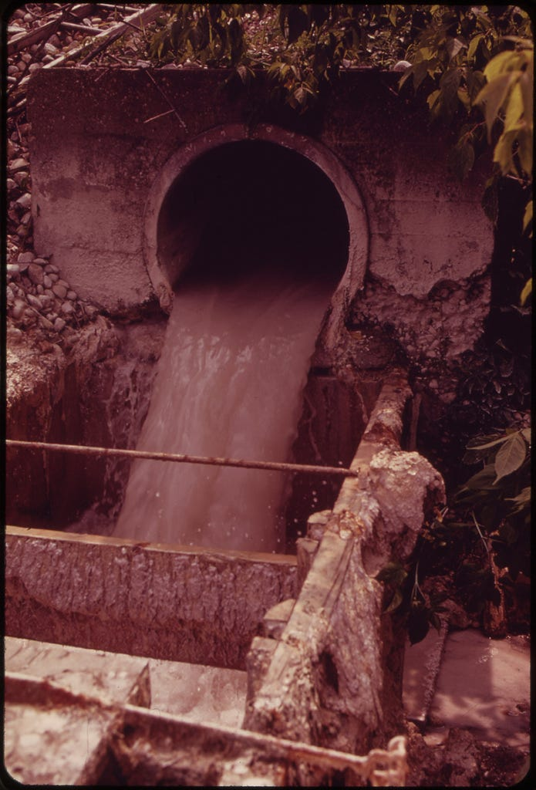
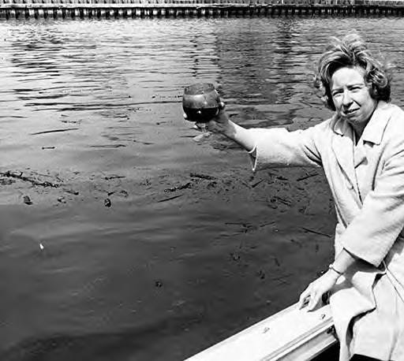
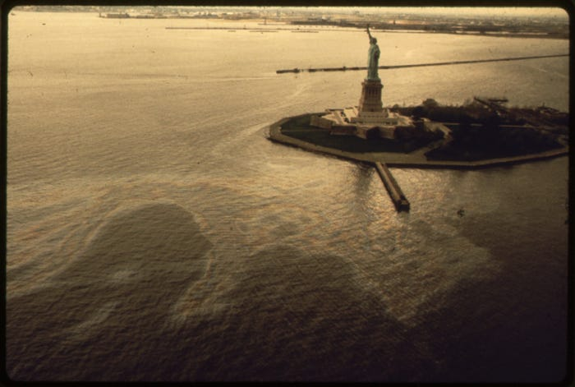
Why Regulate Water Quality?
The Cuyahoga is infamous for its 13 fires, but this wasn’t rare. The Delaware River in Philadelphia, Baltimore harbor, the Buffalo river, and the Rouge River in Detroit also caught fire. NYC harbor had 300 oil spills in the first six months of 1973.
Figures: (from left) Cuyahoga river water, NYC oil slick in 1973, and paper mill effluent on the Androscoggin river in Maine. Source.

Slide 4
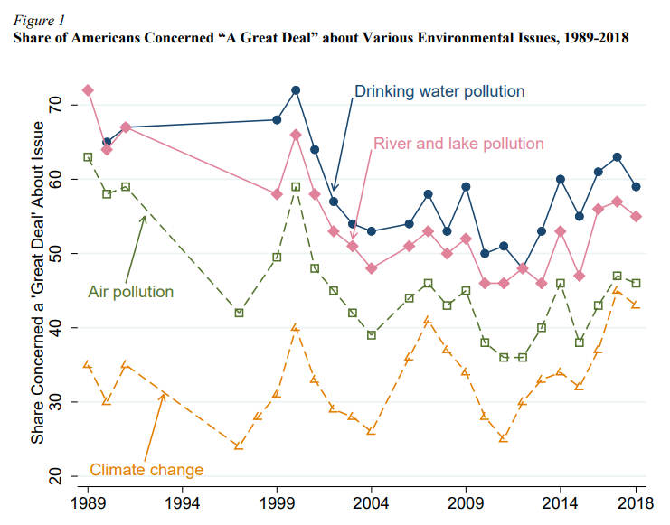
Why Regulate Water Quality?
Surface water quality is still a major concern for most Americans as of 2018.
Source: Keiser and Shapiro (2019).

Slide 5
Background on the CWA
Congress has the authority to regulate interstate commerce and hence navigable waters, which provided the basis for a series of water pollution control acts culminating in the 1972 Clean Water Act (CWA). The act does not directly regulate drinking water.
Its goals:
Make all navigable waters (i.e., “Waters of the United States”) fishable and swimmable by 1983.
Eliminate all discharge of pollution into navigable waters of the US by 1985.
Prohibit discharge of toxic quantities of toxic pollutants.

Slide 6
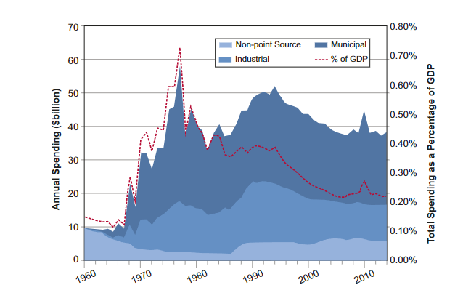
Background on the CWA
From 1960 - 2014, the U.S. spent $1.9 trillion total, or $140 per person per year, to abate water pollution. This was an average 0.2% of annual national income.
The CWA has been costly, controversial, and under-studied.
Source: Keiser, Kling, and Shapiro (2018).

Slide 7
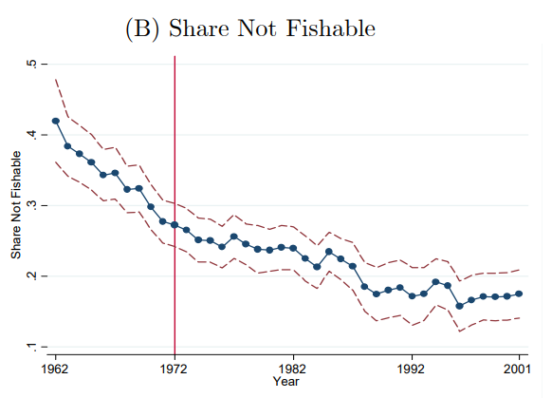
50 Years Later
Share of waters that are fishable grew by 12 percentage points from 1972-2001.
It cost $1.5M to make one river-mile fishable.
Source: Keiser and Shapiro (2019).
Notes:
“Fishable” readings have BOD below 2.4 mg/L, dissolved oxygen above 64 percent saturation (equivalently, dissolved oxygen deficits below 36 percent), fecal coliforms below 1000 MPN/100mL, and TSS below 50 mg/L. “Swimmable” waters must have BOD below 1.5 mg/L, dissolved oxygen above 83 percent saturation (equivalently, dissolved oxygen deficits below 17 percent), fecal coliforms below 200 MPN/100mL, and TSS below 10 mg/L. The definition also includes standards for boating

Slide 8
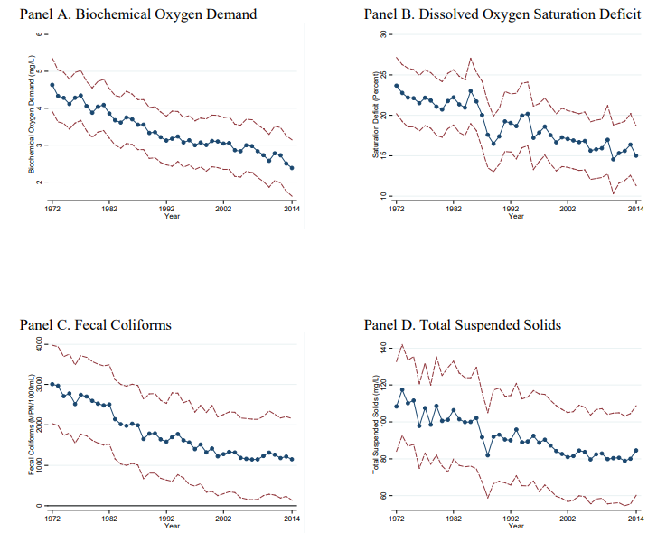
50 Years Later
Notable improvements in key water quality indicators
Using alternative criteria of fishability, others have estimated that over one third of water systems in the US remain un-swimmable and half are not suitable for fishing (Environmental Integrity Project, 2022).
Source: Keiser and Shapiro (2019).

Slide 9
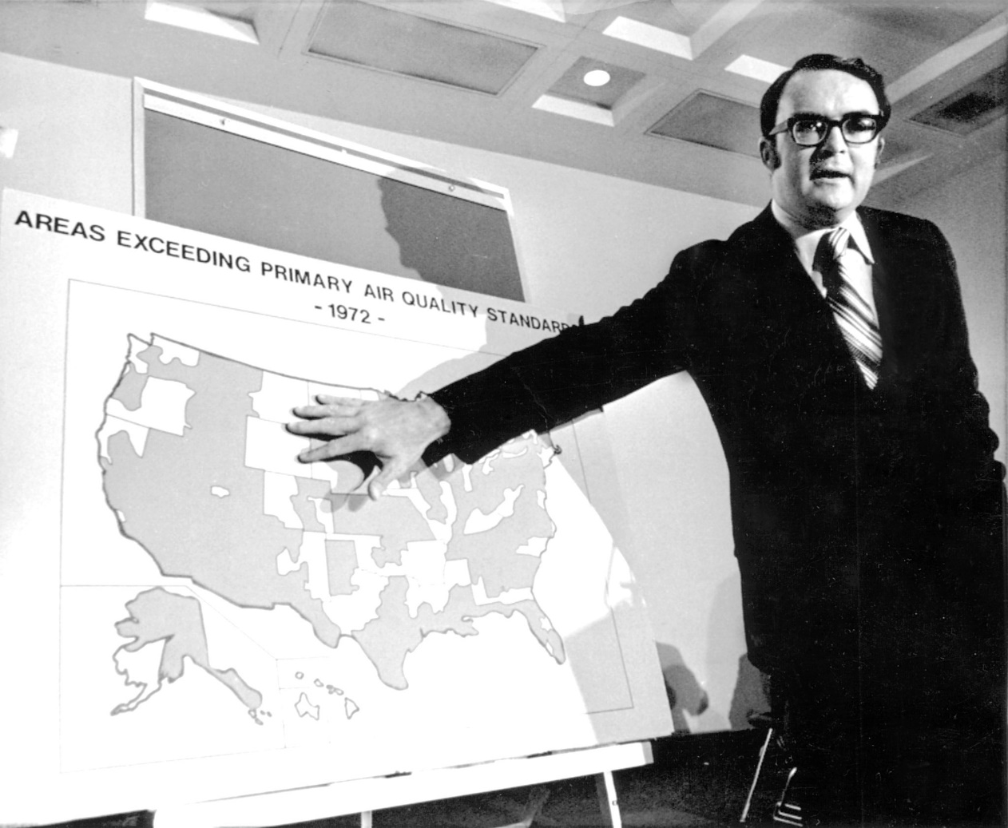
Progress 50 Years Later
William Ruckelshaus: “even if all our waters are not swimmable or fishable, at least they are not flammable.”
Image source: NYT.

Slide 10
Part 1: Regulatory Instruments in the Clean Water Act

Slide 11
Regulatory Instruments in the Clean Water Act
The 1972 Clean Water Act has three main regulatory instruments.
Water Quality Standards
Point source discharge regulations
National Pollution Discharge Elimination System (NPDES) Permits
Effluent Limitation Guidelines (ELGs)
Abatement subsidy programs
Grants and later loans through the State Revolving Fund (SRF)

Slide 12
1) Water Quality Standards
How are Water Quality Standards set for a given body of water?
States determine potential uses of the water (e.g., swimming, fishing, boating, and drinking source).
States then set standards for water quality that are consistent with the designated uses. There are recommended but non-enforceable federal standards.
Numeric vs. narrative standards (e.g., “free from floating petroleum oils”).
States determine if a body of water is impaired. If a body of water is impaired, states implement more stringent permit limits and sometimes total maximum daily loads (TMDLs) to try to reduce pollutant loadings.
Impairment designations are updated every 2-3 years, and the public has an opportunity to comment.

Slide 13
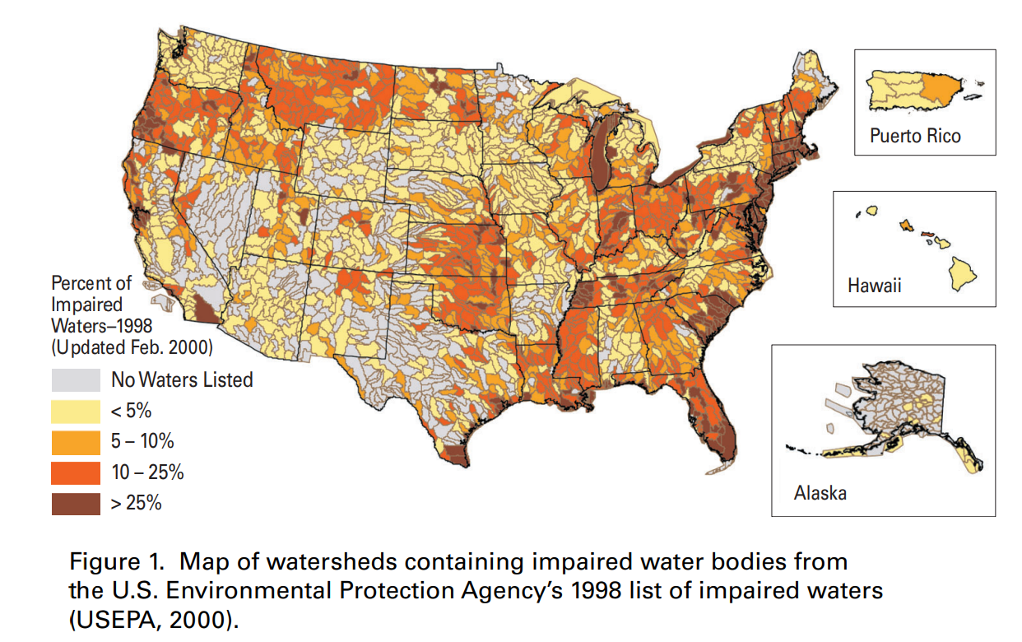

Slide 14
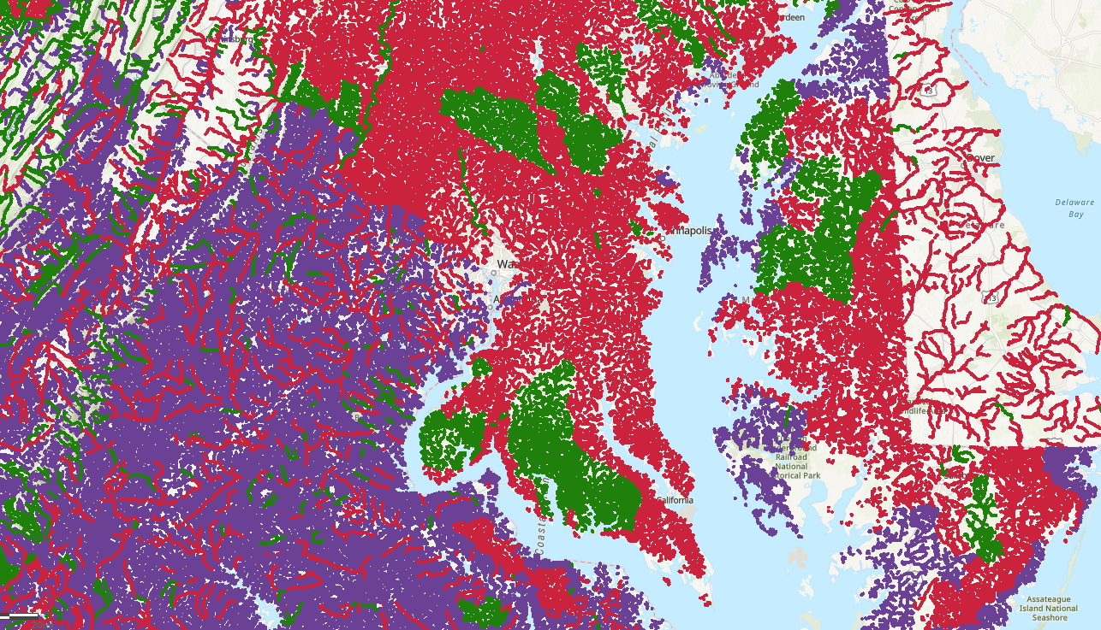
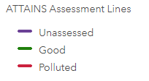
ATTAINS Data in the Chesapeake Region
The national ATTAINS dataset provides information on impaired waters by specific stream reach. Download ATTAINS data.

Slide 15
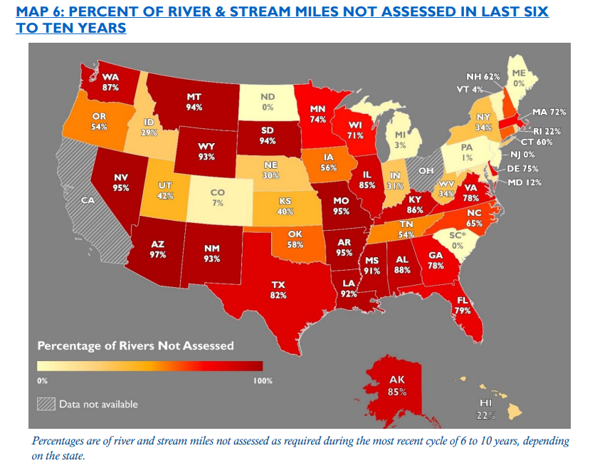
State Performance on Assessing Water Quality Standards
Source: Environmental Integrity Project (2022).

Slide 16
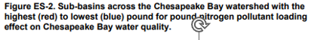
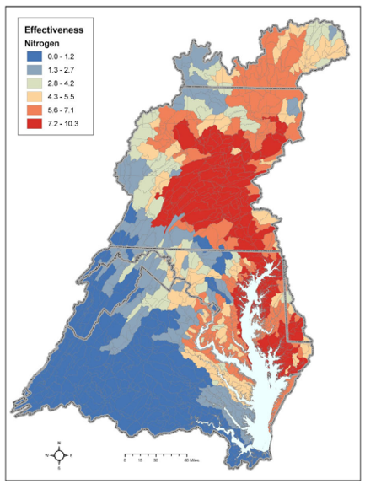
Chesapeake Bay Total Maximum Daily Load (TMDL)
The Chesapeake Bay is impaired because of excess nitrogen, phosphorus and sediment. Several states within the watershed signed an agreement to ameliorate the bay.
States (+DC) entered an MOU and set new water quality standards.
Each state received allocation shares for nutrient and sediment caps based on their initial contributions.
25% less N, 24% less P, and 20% less TSS relative to 2009
Each contributor created a watershed implementation plan. Some states created trade-able permits for their allocation.
Monitoring was enacted across the Chesapeake watershed.
Source: EPA, 2010.

Slide 17
2) Point Source Discharge Regulations
Any facility that releases pollution directly into a navigable water from a point source is required to obtain a NPDES permit for that release.
NPDES permits specify the amount of discharge permissible for a given facility.
Release quantities cannot result in loss of a current designated use for a body of water.
Permits must be renewed every five years, and thus can be made more stringent over time.
All permitted facilities and discharge quantities can be accessed on Enforcement and Compliance History Online’s Discharge Monitoring Reports.
All facilities with a NPDES permit must measure conventional pollutant releases.
Biochemical oxygen demand (BOD), Total suspended solids (TSS), pH, Fecal coliform, Oil and grease.

Slide 18
Effluent Limitation Guidelines
For some industrial categories, NPDES permits must follow Effluent Limitation Guidelines (ELGs). These are numeric limits based on the performance of specific technologies, but specific techs are rarely required. Permit limits are set by states often using “Best Professional Judgement.”
Direct Dischargers:
Best Practicable Technology
Best Conventional Technology
Best Available Technology
New Source Performance Standards
Identify all source types and abatement technologies
Industrial Category
Indirect Dischargers:
Pre-treatment Standards for Existing Sources
Pre-treatment Standards for Existing Sources

Slide 19
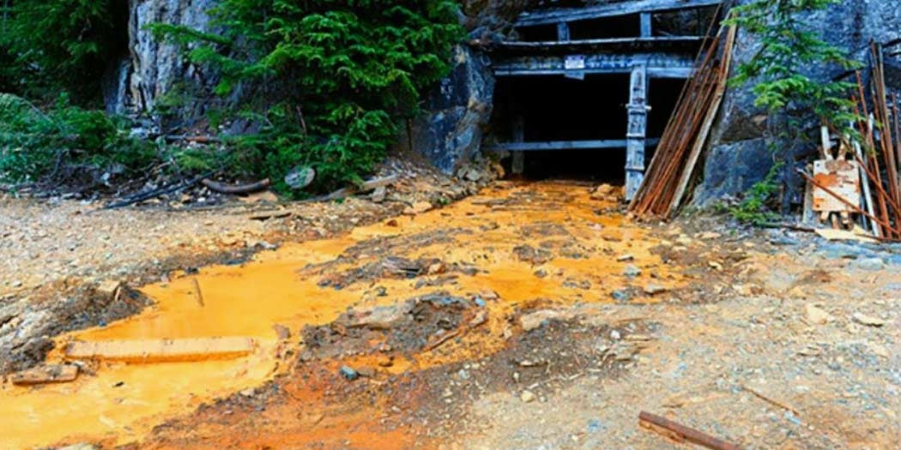
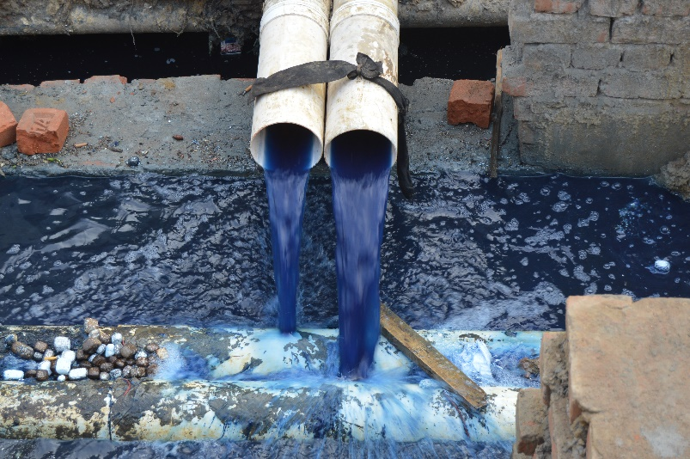
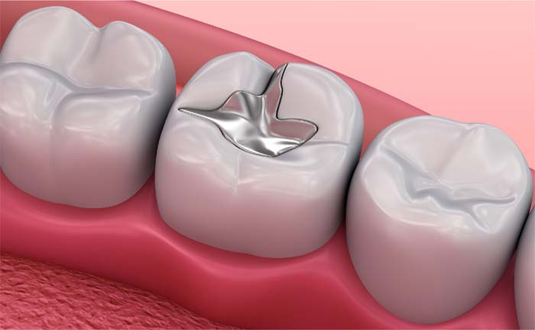
ELG Examples
Many industrial source categories, although ELGs are not updated frequently for newer technologies:
Steam-Generating Power Generating Plants
Coal Mining
Dental Offices
Meat and Poultry Products
Textile Mills
Oil and Gas Extraction
Landfills

Slide 20
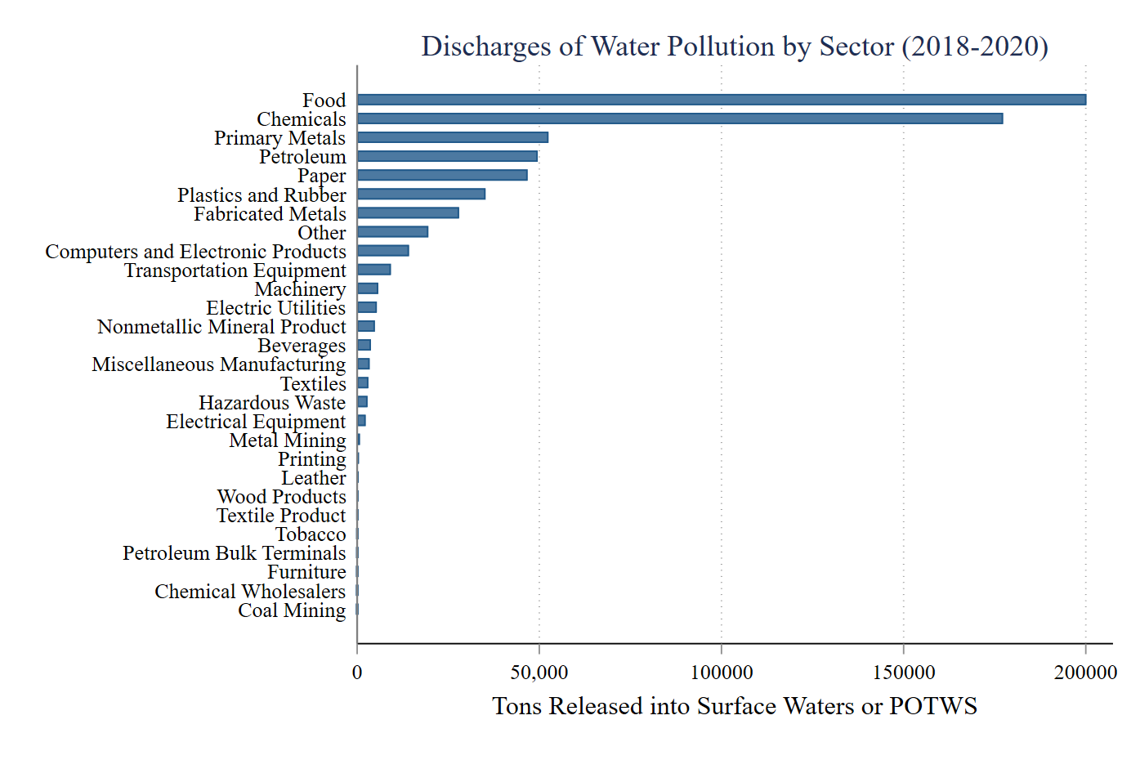
Source: TRI Basic, 2018-2020 files.

Slide 21
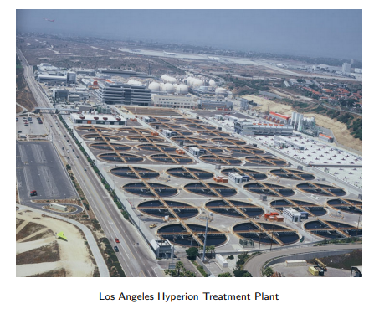
3) Abatement Subsidy Programs
Publicly-Owned Treatment Works (POTWs) receive and treat wastewater before discharging it.
The CWA established grant programs to improve treatment practices.
In 1987 the grants program was replaced by a low-interest loan program to communities, companies, non-profits, states. Also features other types of subsidies.
Funds a broader set of projects such as nonpoint source amelioration, green infrastructure, water reuse, stormwater treatment, watershed protection programs, etc.
Link

Slide 22
Part 2: Key Terms

Slide 23
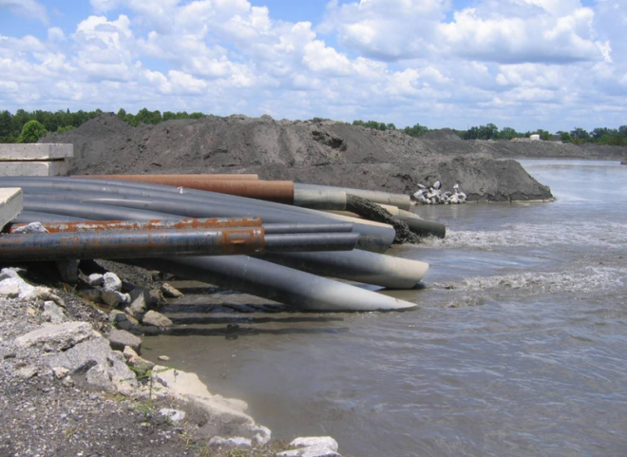
"Point Source"
For jurisdictionality, the CWA distinguishes between point source and non-point source water pollution. Point sources are:
“discernible, confined, and discrete conveyance, including … any pipe, ditch, channel, tunnel, conduit, well, fissure, container, rolling stock, concentrated animal feeding operation, or vessel … from which pollutants are or may be discharged.”
Wastewater discharge from the Bucks Steam-Generating Electricity Plant in Bucks, Alabama.

Slide 24
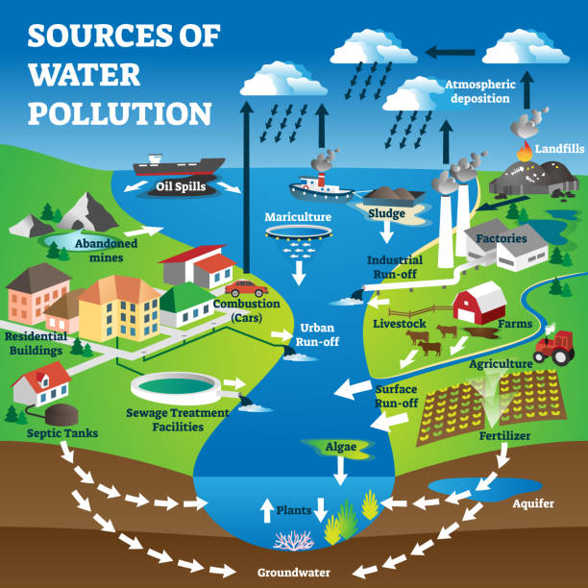
Point Sources
Image source: iStockphoto by Getty images.

Slide 25
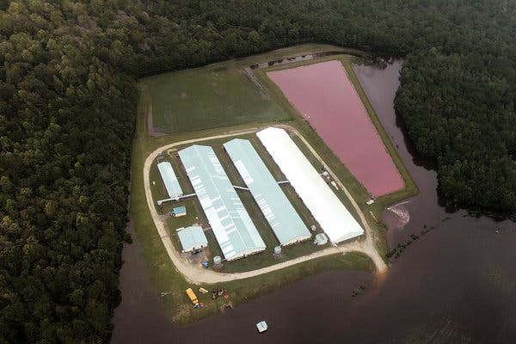
Aside: Point Sources and CAFOs
Concentrated animal feeding operations are specifically listed as a “point source,” but what is a CAFO?
A CAFO is any livestock operation where animals are kept for at least 45 days a year and not pastured.
Source: “Lagoons of Pig Waste Are Overflowing After Florence.” NYT.

Slide 26
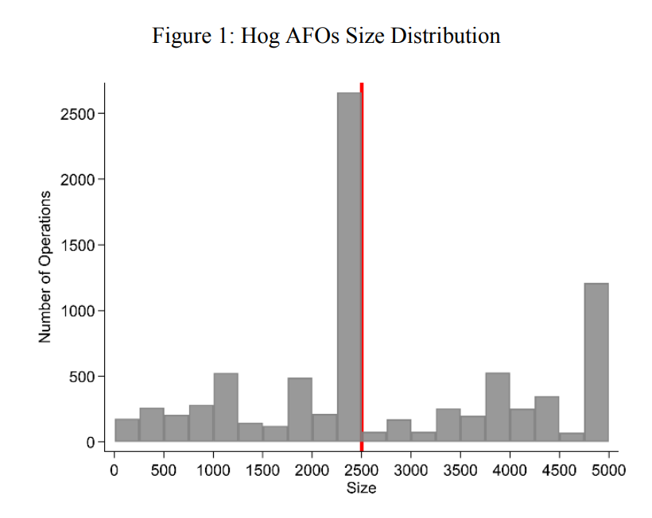
Aside: Point Sources and CAFOs
Only some “large” CAFOs and rarely medium-sized ones require a permit. 2,500 pigs is “large.”
Size-based regulations create perverse incentives to avoid permitting and oversight.
Source: Size-based regulations, productivity, and environmental quality. Chen et al. (2019).

Slide 27
"Waters of the United States"
Clear examples of WOTUS:
Navigable rivers and lakes
Interstate waters
Territorial seas up to 200 miles
Somewhat ambiguous:
Groundwater
Wetlands
Tributaries of major rivers
Ephemeral, intermittent, and perennial streams

Slide 28
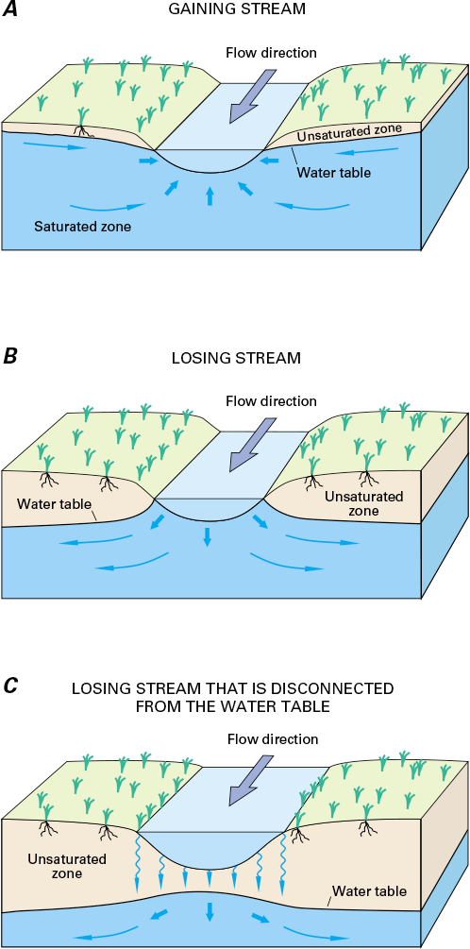
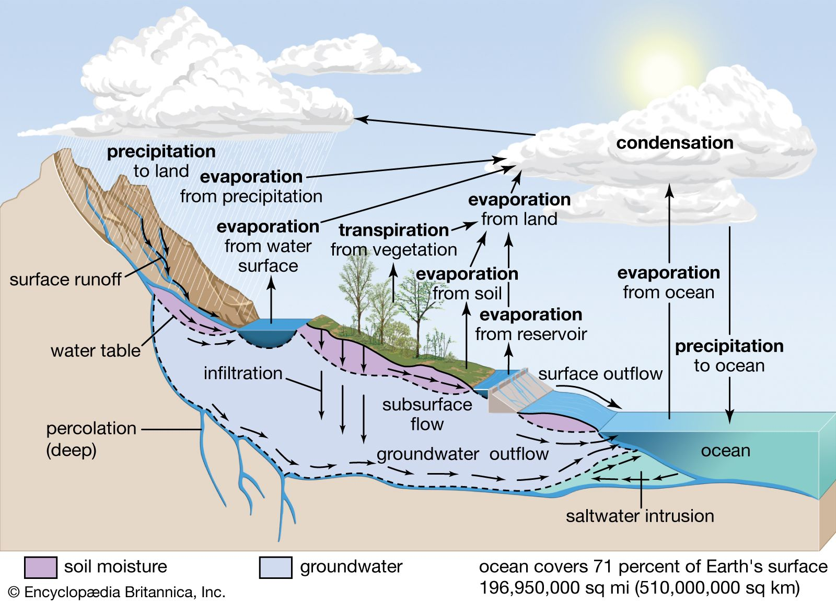
Basic Hydrology and Hydrogeology
Congress required the CWA “restore and maintain the chemical, physical and biological integrity of the Nation's waters.”
Sources: Integrate Student Materials and Encyclopedia Britannica.

Slide 29
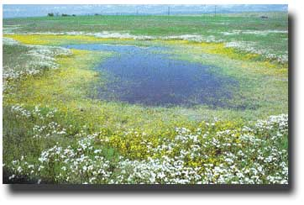
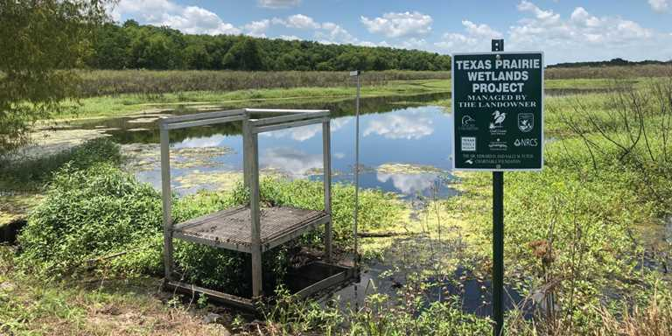
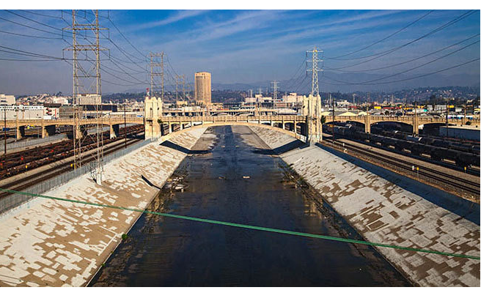
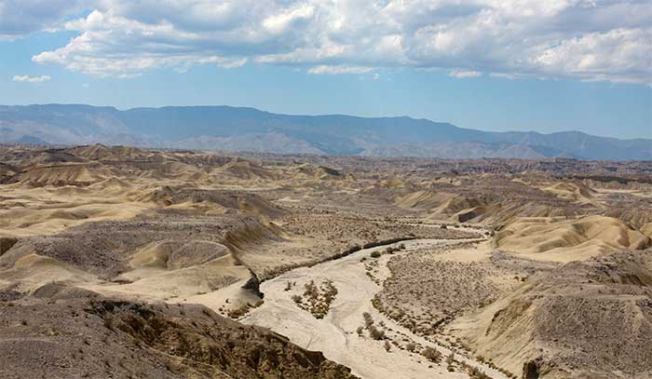
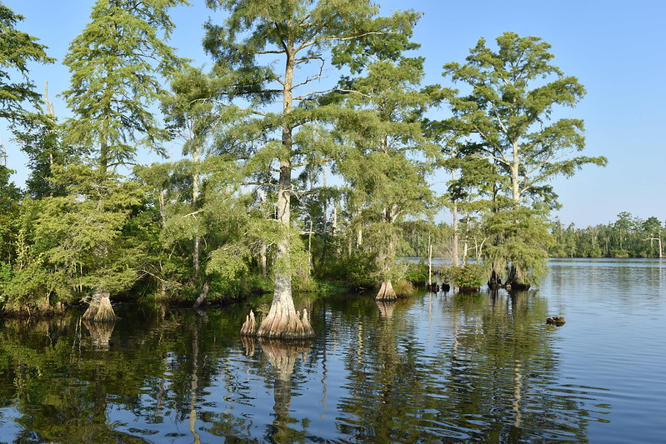
Tension in Defining "Waters of the United States"
All google images: (from left, clockwise) The LA River, California vernal ponds, Texas prairie wetlands, ephemeral desert riverbed, pocosins in South Carolina.

Slide 30
Part 3: Evolution of the CWA

Slide 31
Early Revisions to WOTUS
The original CWA only applied to navigable waters. Several revisions were codified by Congress or established by case review. These generally expanded “jurisdictional” waters, i.e., features that are subject to the rules of the CWA:
1977 Amendments
Non-navigable tributaries are jurisdictional because they affect navigable waters.
Wetlands adjacent to or hydrologically connected to WOTUS are also jurisdictional.
Wetlands recharge water levels, absorb pollutants, and provide habitat.
U.S. v Riverside Bayview Homes (1985) decided that waters totally confined to one state are also jurisdictional.

Slide 32
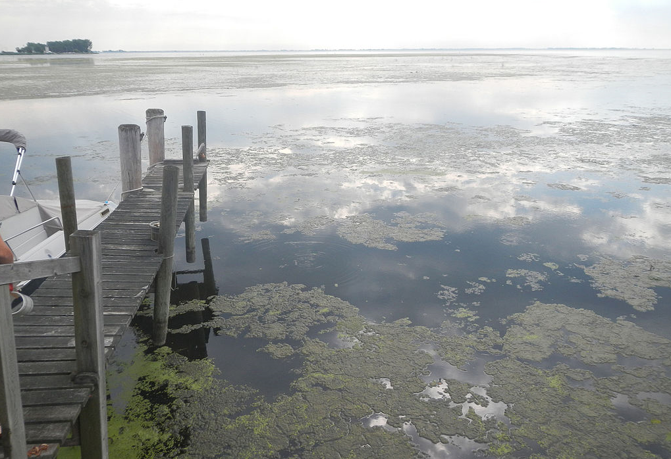
Rapanos vs. U.S. (2006)
John Rapanos filled over 20 acres of wetlands near Lake St. Claire, Michigan, in preparation to build a mall. He did not seek a permit, and the Army Corps of Engineers filed an injunction for him to stop building.
This was the same lake that had been the subject of the Riverside Bayview Homes supreme court case. State regulators argued that the wetlands had been established as jurisdictional.
Rapanos sued to avoid paying $25,000 fines per day, eventually paying settlement costs of nearly $1m without admitting fault.
Source: Lake St. Clair’s chronic problems have not only gone unresolved over the decades; there isn’t even consensus on what’s causing them.

Slide 33
Rapanos vs. U.S. (2006)
The Supreme Court did not reach a firm decision, but it elaborated on two jurisdictional tests:
Scalia test: jurisdiction extends to relatively permanent bodies of water, including wetlands, that are connected to navigable waters.
Kennedy test: jurisdiction extends to any waters, including wetlands, acting as a significant nexus for traditional navigable waters.
Significant nexus: the wetlands or other water must “significantly affect the chemical, physical, and biological integrity” of navigable waters.
Ultimately, the Army Corps of Engineers and EPA established that a body of water is jurisdictional if it meets either the Scalia test or the Kennedy test.

Slide 34
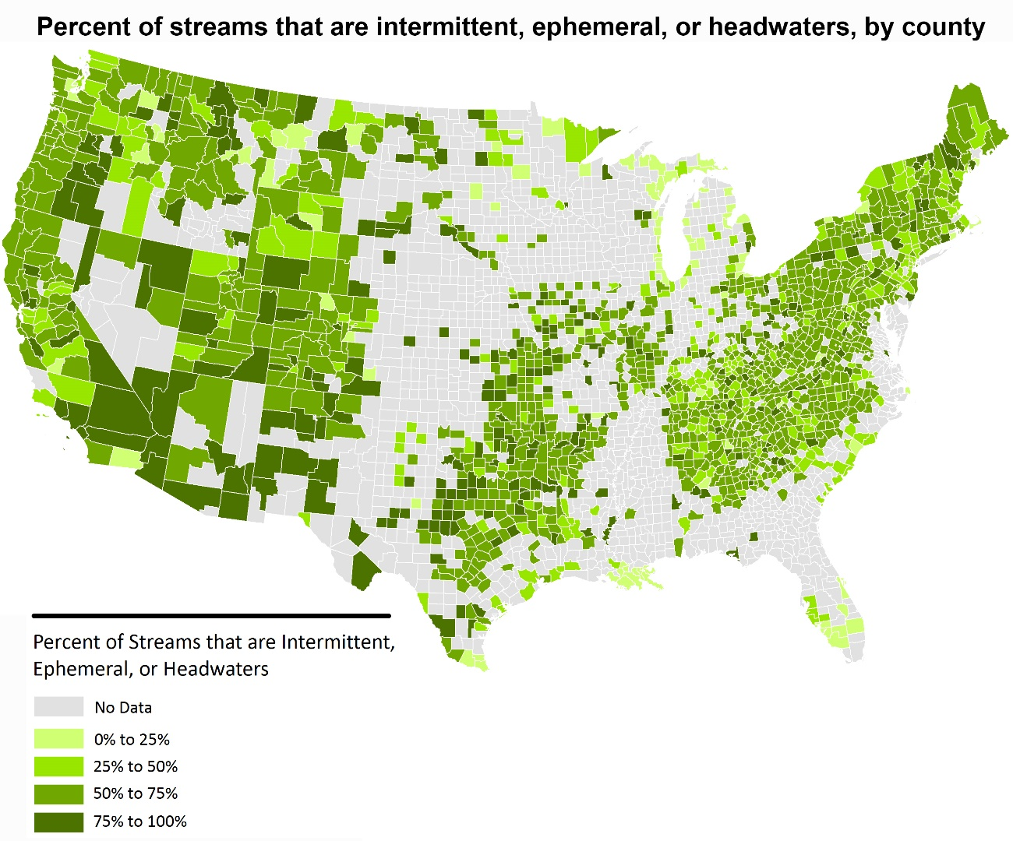
Clean Water Rule (2015)
The Clean Water Rule built on the connections inherent to hydrogeologic systems, using the significant nexus test in re-evaluating jurisdictionality.
Previously non-jurisdictional waters were determined to significantly affect the chemical, physical, and biological integrity of WOTUS.
Dramatic increase in jurisdictionality: intermittent streams and many wetlands all became WOTUS.
Source: Brookings Institute, 2015.

Slide 35
Navigable Waters Protection Rule
The Clean Water Rule was repealed in 2019. The “Navigable Waters Protection Rule” established a new standard for what is jurisdictional. The NWPR excluded some ambiguous categories of WOTUS:
Half of wetlands were excluded, including any separated by dunes or natural land from other water (26.4m wetland acres)
All ephemeral streams and an estimated 70% of all streams (600,000 stream miles)
It also excluded categories of WOTUS established by precedent:
Navigable non-interstate watersheds
Human constructions, even if the body of water is used for drinking water or recreation.

Slide 36
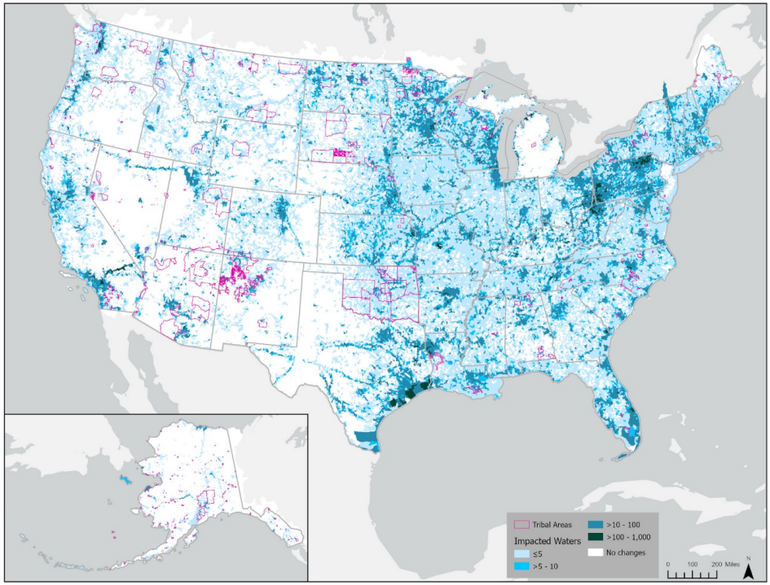
Return to Rapanos
In returning to the Rapanos criteria, EPA mentioned costs of the NWPR’s jurisdictional changes: filling of streams, less wetlands, less flow, water quality, species loss, lower ecosystem values, oil spill risk, drinking water treatment costs, increased flood risk.
Shelia Olmstead’s podcast with RFF on the challenges to the clean water rule.
Source: Economic Analysis for the Revised WOTUS (2021).

Slide 37
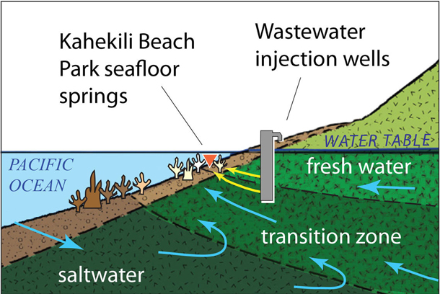
County of Maui v. Hawaii Wildlife Fund (2020)
Recent supreme court developments
County of Maui v. Hawaiʻi Wildlife Fund.
A NPDES permit is required if the pollution into groundwater is the functional equivalent of a direct release into navigable waters through a point source.
Source: USGS.

Slide 38
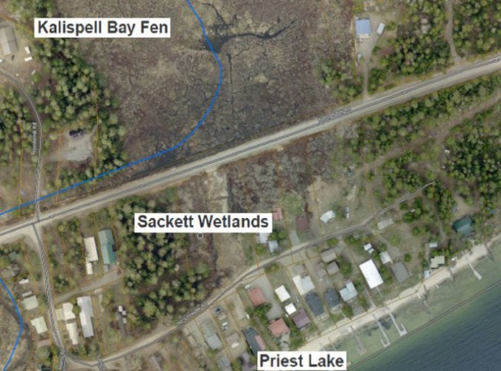
Sackett vs. EPA (2023)
Sackett vs. EPA
WOTUS are relatively permanent, standing or continuously flowing streams, oceans, rivers, and lakes
WOTUS must have a continuous surface connection to rivers and lakes forming WOTUS
Read a great article about Sackett by the NRDC.
Source: EarthJustice.

Slide 39
Extent of CWA Coverage
Evolution of WOTUS
2/3rds of Streams, ½ of wetlands protected
Clean Water Act (1972)
Clean Water Act (1977)
Rapanos Tests (2008)
Biden’s first WOTUS (2021)
Less
Jurisdiction
More
Jurisdiction
Navigable Waters Protection Rule (2020)
Sackett and Maui decisions (2023)
Clean Water Rule (2015)
½ of streams, 1/3rd of wetlands protected

Slide 40
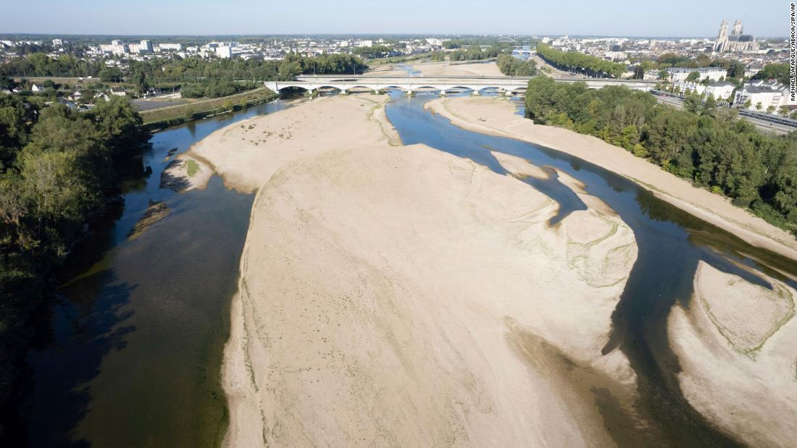
Continuing Challenges
Jurisdictionality.
Nonpoint source pollution.
Quantity of water use.
Climate change.
Missing benefits.
The Rhine river in August of 2022. Source: CNN, 2022.

Slide 41
Part 4: Economics and the Clean Water Act

Slide 42
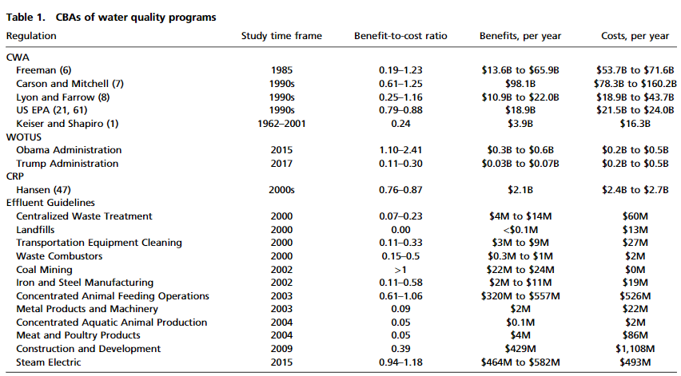
A Puzzle for BCA in Water Rules
Recent retrospective analyses show that the median benefit-cost ratio of CWA regulations is 0.37.
Source: Keiser, Kling, Shapiro (2018) The low but uncertain benefits of US water quality policy.

Slide 43
Keiser and Shapiro (2019)
In a related paper on the costs and benefits of the grants program portion of the CWA, Keiser and Shapiro (2019) ask:
How has water quality changed since the CWA was passed?
How much of the changes were caused by the CWA’s grants program?
How much do residents value these changes?

Slide 44
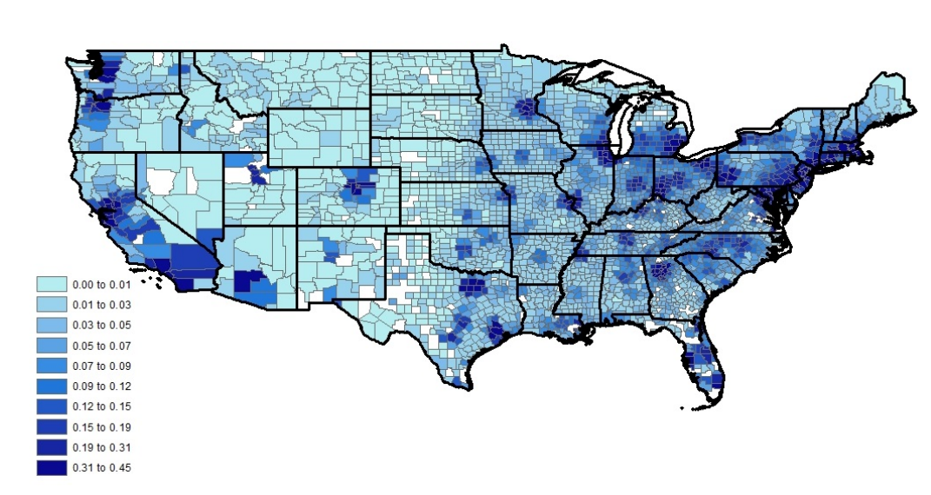
Keiser and Shapiro (2019)
Hedonic results on home values:
The average grant project cost $31m and increased home values within 25 miles by $7m.
BC ratios less than one.

Slide 45
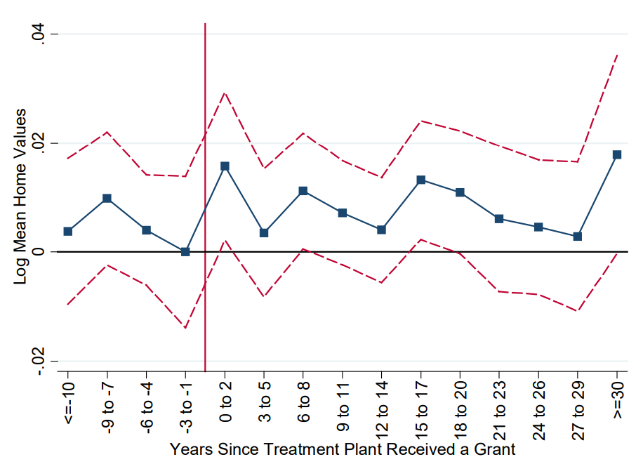
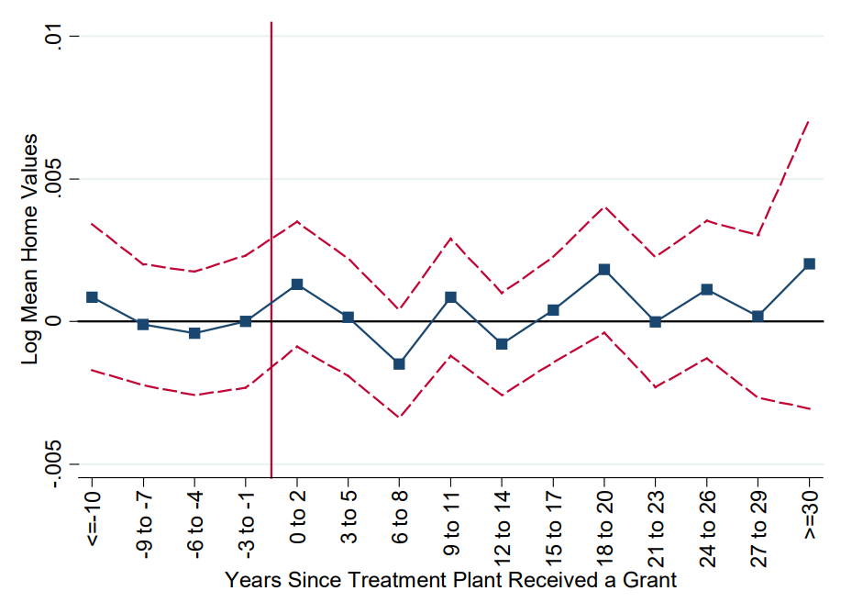
Keiser and Shapiro (2019)
Home values within 0.25 miles.
Home values within 25 miles

Slide 46
Keiser and Shapiro (2019)
Why might hedonic estimates of grant impacts undercount true benefits?
Hedonic model mainly counts amenity value of being on the body of water, not all recreation.
Health impacts are not included but may be substantial (Flynn and Marcus, 2022).
Existence and non-use values.
Exxon Valdez SP WTP was 1000x revealed preference (Kling et al., 2012).
Notes:
Note that this paper does not consider the effects of NPDES programs and limits, only grants to POTWs.

Slide 47
A Puzzle for BCA in Water Rules
Do the costs of US water quality regulations not exceed their benefits, or do existing analyses substantially understate true benefits?
Older stated preference studies did not necessarily incorporate frontier methods with respect to consequentiality and incentive compatibility.
Measurement error biases recreation demand estimates to zero.
Incomplete information by households biases hedonic estimates.
Many unquantified benefits including:
Health benefits
Existence values.
Non-standard pollutants.

Slide 48
A Puzzle for BCA in Water Rules
Can stated preference help? In some cases, but more research is needed.
Intrinsic value of ecosystem food webs are complex and not generally known to survey respondents.
Cultural values associated with the existence of species, habitats, and specific features are difficult to transfer across sites.
Iconic bodies of water require specific stated preference studies.

Slide 49
Next class
Next class will cover the Safe Drinking Water Act. I will also go over your fourth and final case study assignment.
Two readings for Wednesday:
Allaire et al. (2018)
Fedinick et al. (2022)
(optional) Keiser et al. (2023)

